Slide 1


Alper Sener
30/12/2021

Slide 2

Outline
Executive Summary
Introduction
Methodology
Results
Conclusion
Appendix

Slide 3
Executive Summary
The Methodology Path is as follows:
Data collection from SPACEX API
Data wrangling from Web (Wikipedia)
Explanatory Data Analysis (EDA) with data visualization
EDA with SQL by using IBM Cloud
Building an interactive map with Folium
Predictive analysis (Classification)
Summary of all results
First, data is collected from different sources.
Second, data is analyzed through different methods.
Last, predictive analysis utilized to find the best model for our data.

Slide 4
Introduction
Project background and context
In this capstone, we have predicted if the Falcon 9 first stage will land successfully.
SpaceX advertises Falcon 9 rocket launches on its website with a cost of 62 million dollars; other providers cost upward of 165 million dollars each, much of the savings is because SpaceX can reuse the first stage.
Therefore, if we can determine if the first stage will land, we can determine the cost of a launch. This information can be used if an alternate company wants to bid against SpaceX for a rocket launch.
Problems you want to find answers
What are the features of successful rockets that are landed without destruction.
Finding out the historic trends from SpaceX’s experiences according to location, orbit et cetera.

Slide 5


Slide 6
Methodology
Data collection methodology:
Via the API of SpaceX (REST)
Via Webscrapping (Wikipedia)
Perform data wrangling
Data is transformed by numpy for Machine Learning algorithms.
Moreover, One Hot Encoding is utilized to have numeric/binary data.
Perform exploratory data analysis (EDA) using visualization and SQL
Subset of data is obtained through SQL and the initial analysis has done through visuals such as, scatter plots and bar charts.
Perform interactive visual analytics using Folium
Perform predictive analysis using classification models
Several classification models have build and compared.

Slide 7
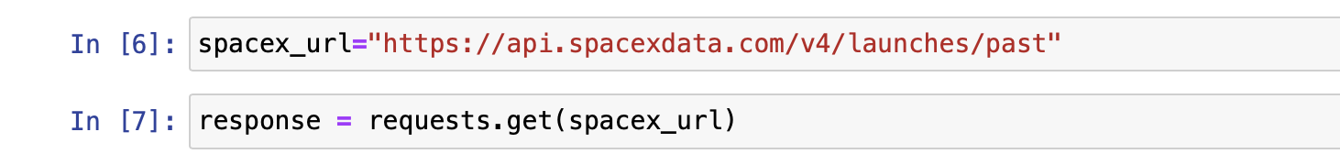
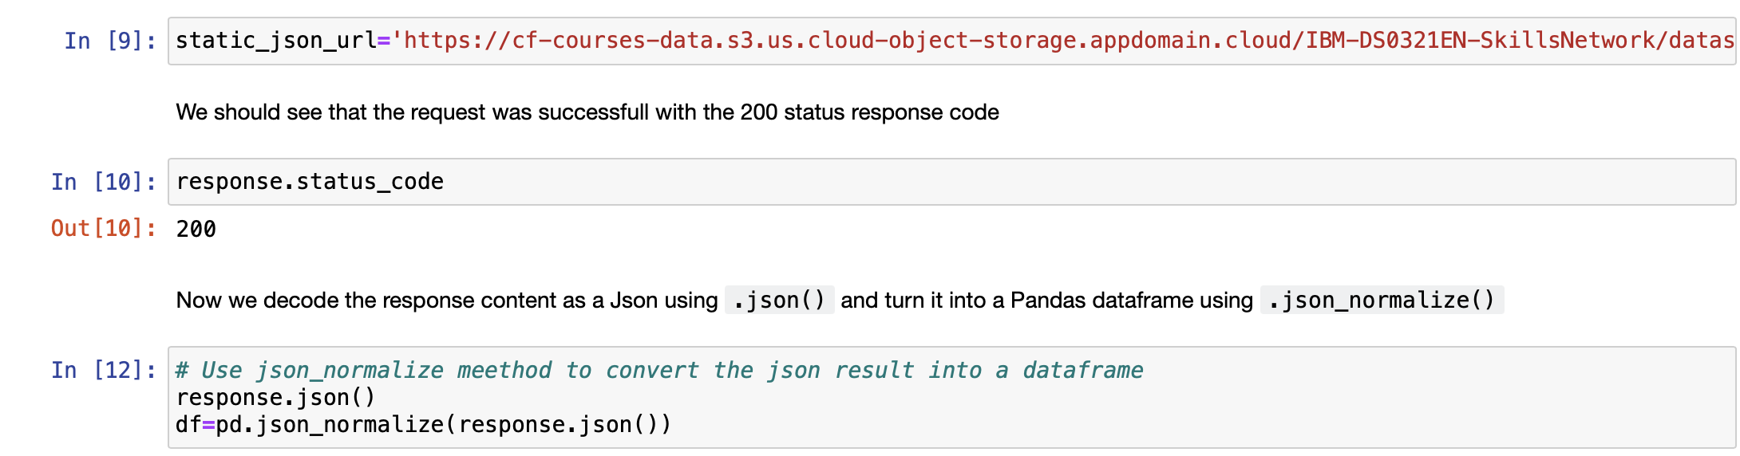
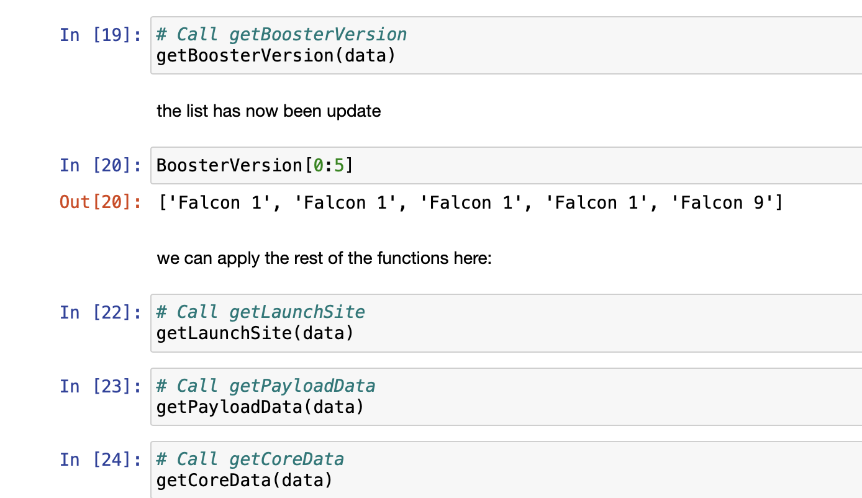
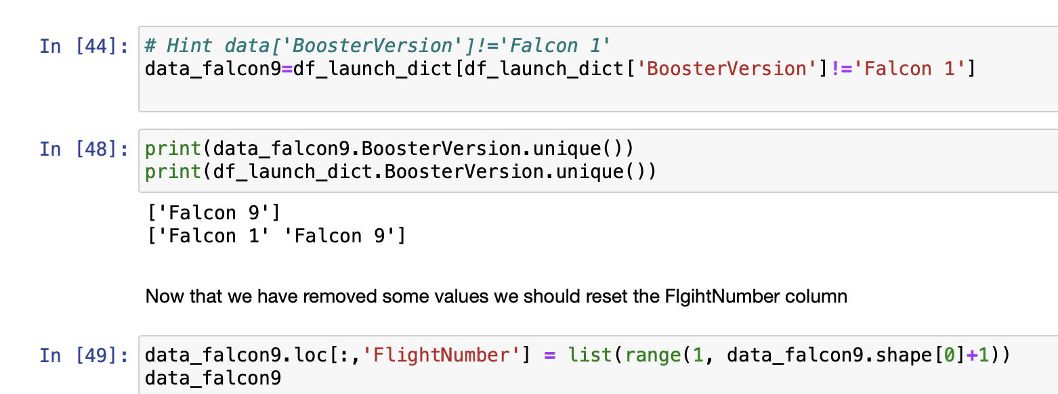
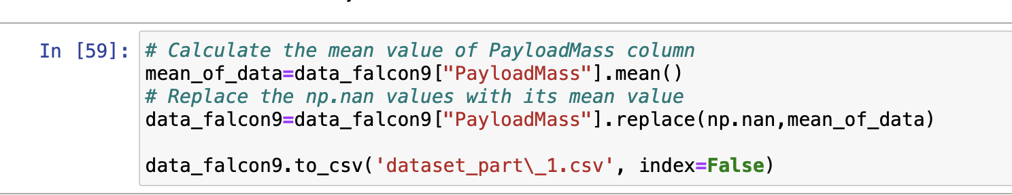
Data Collection – SpaceX API
Getting Response from API
Convert Response as a Json
Apply Custom Functions
Assign list to dictionary then dataframe
Filter dataframe and export to a file
GİTHUB URL EKLE!!

Slide 8
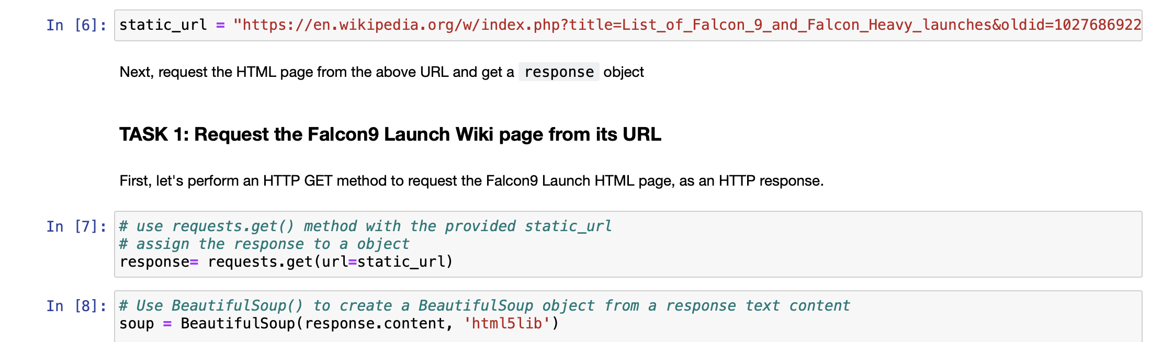
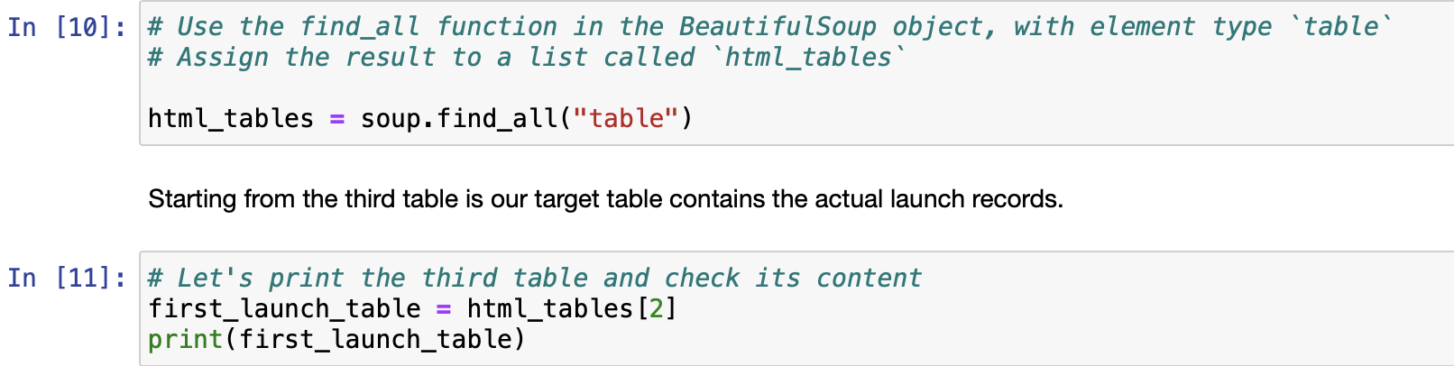
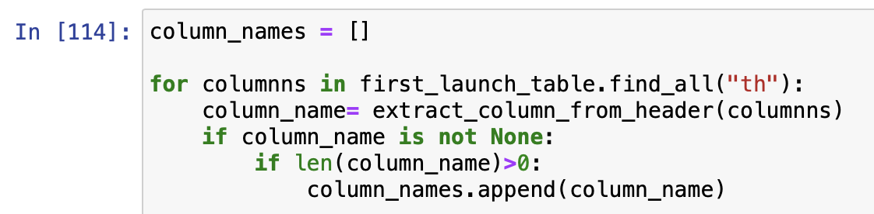
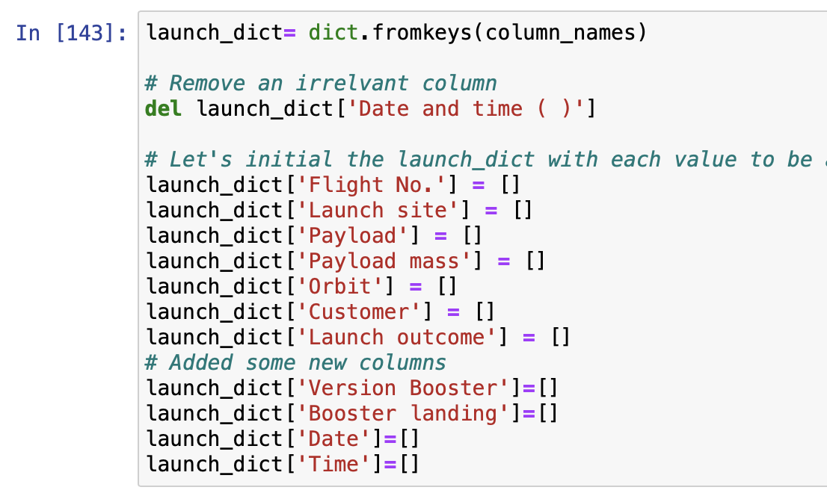
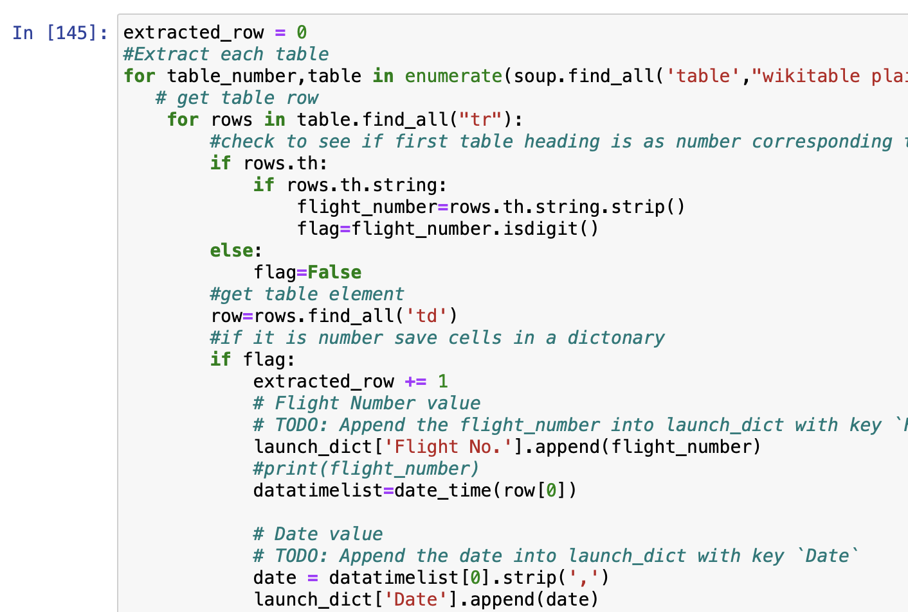
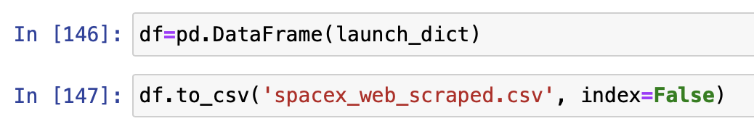
Data Collection - Scraping
Getting Response from HTML
Creating Beautifulsoup Object
Finding tables in the URL
Deducing Column Names
Creating a new dictionary
Append data to the related keys
Convert dictionary to a dataframe and export to a file
GİTHUB URL EKLE!!

Slide 9
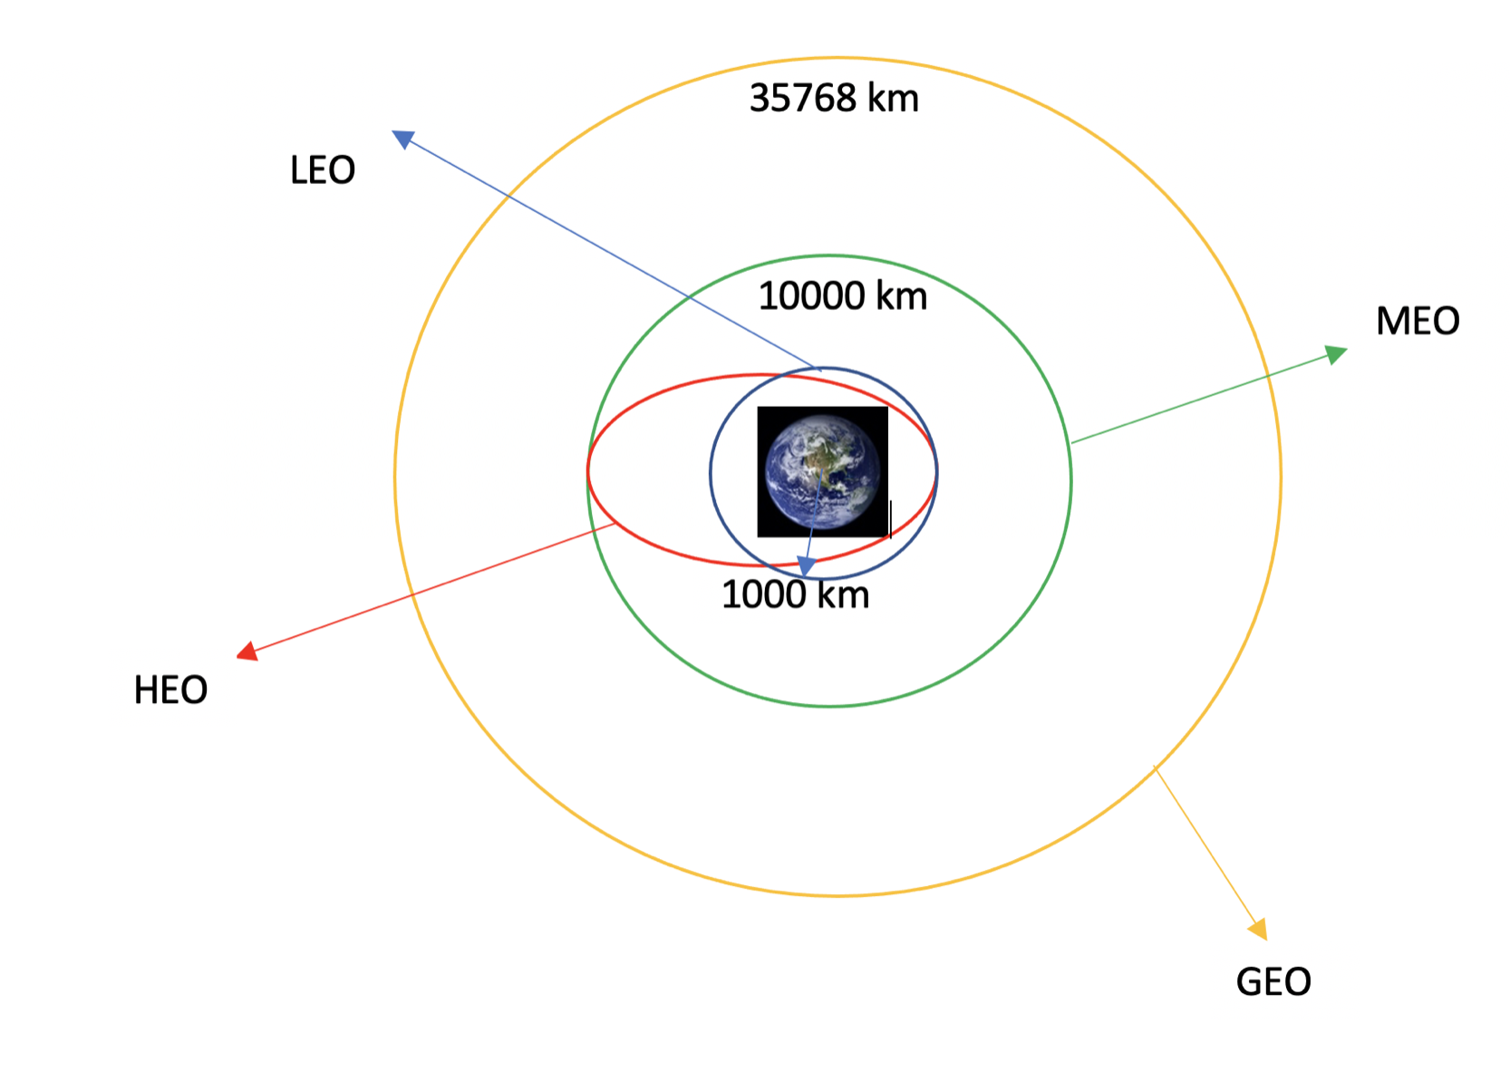
Data Wrangling
We have performed some Exploratory Data Analysis (EDA) to find some patterns in the data and determine what would be the label for training supervised models.
Load Data
Create a dataframe from the Data
Clean the null and irrelevant values from the data
Create quantitative columns if there are not (One hot coding)
Export results to a file
GİTHUB URL EKLE!!

Slide 10
EDA with Data Visualization
We drawn following scatter plots
We drawn following bar plots
Flight Number & Payload Mass
Flight Number & Launch Site
Payload & Launch Site
Orbit & Flight Number
Payload & Orbit Type
Orbit & Payload Mass
Success Rate & Orbit Type
We drawn following line charts
Success Rate & Year
GİTHUB URL EKLE!!

Slide 11
EDA with SQL
Using bullet point format, summarize the SQL queries you performed
The names of the unique launch sites in the space mission
Initial 5 records where launch sites begin with the string 'KSC’
The total payload mass carried by boosters launched by NASA (CRS)
Average payload mass carried by booster version F9 v1.1
The date where the successful landing outcome in drone ship was achieved.
The names of the boosters which have success in ground pad and have payload mass between 4000 and 6000
The total number of successful and failure mission outcomes
The names of the booster versions which have carried the maximum payload mass.
The records which will display the month names, successful landing outcomes in ground pad, booster versions, launch site for the months in year 2017
Ranking the count of successful landing outcomes between two dates in descending order.
GİTHUB URL EKLE!!

Slide 12
Build an Interactive Map with Folium
First, we point out the Latitude and Longitude Coordinates of SpaceX sites. Then, we add these as a Circle Marker around each launch site with a label of the name of the launch site.
It is very good structure to visualize the launch datas.
Then, we assigned the dataframe classes as 0 and 1 with different colors to have required attention. Moreover, we show them on the map by a MarkerCluster( ).
Some examples that we analyze:
Are launch sites near to railways?
Are launch sites near to highways?
Are launch sites near to coastline?
Do launch sites keep certain distance away from cities?
GİTHUB URL EKLE!!

Slide 13
Build a Dashboard with Plotly Dash
I could not write a dashboard…

Slide 14
Predictive Analysis (Classification)
First, we build the model
Then, we evaluate the builded models
Accuracy, f1_score and Jaccard score are calculated for each model
Hyperparameters are determined for each type of algorithms
Confusion Matrix
Load dataset as Pandas
Transform it as Numpy Data
Split data into training and test sets
Check how many test and train samples are there
Build different types of machine learning algorithms we want to use
Set our parameters and algorithms to GridSearchCV
Fit our datasets into the GridSearch objects and train our dataset.
Finally, we find the best performing models
The model with the best scores (accuracy, f1, jaccard) wins the best performing model
GİTHUB URL EKLE!!

Slide 15
Results
Exploratory data analysis results
Interactive analytics demo in screenshots
Predictive analysis results

Slide 16


Slide 17
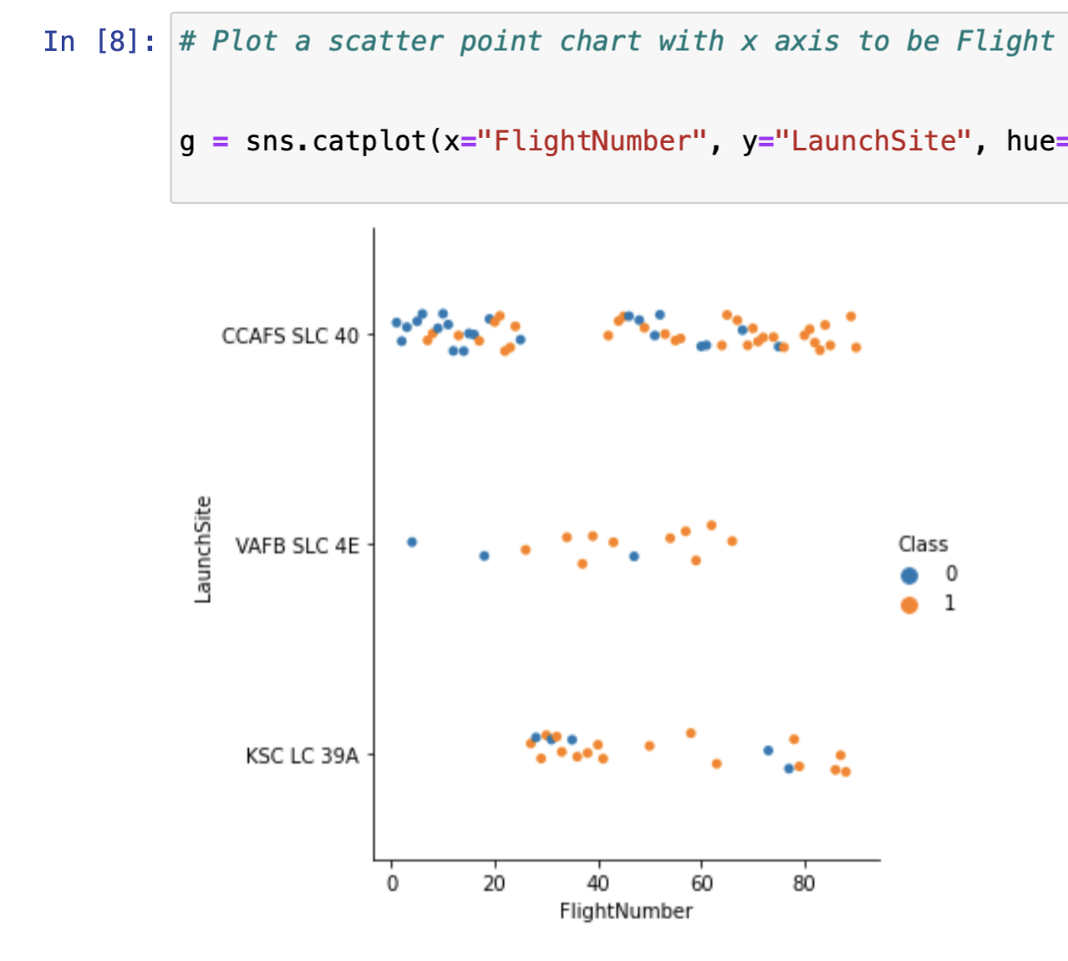
Flight Number vs. Launch Site
Increased number of flights at a launch site is resulted as a greater success rate.

Slide 18
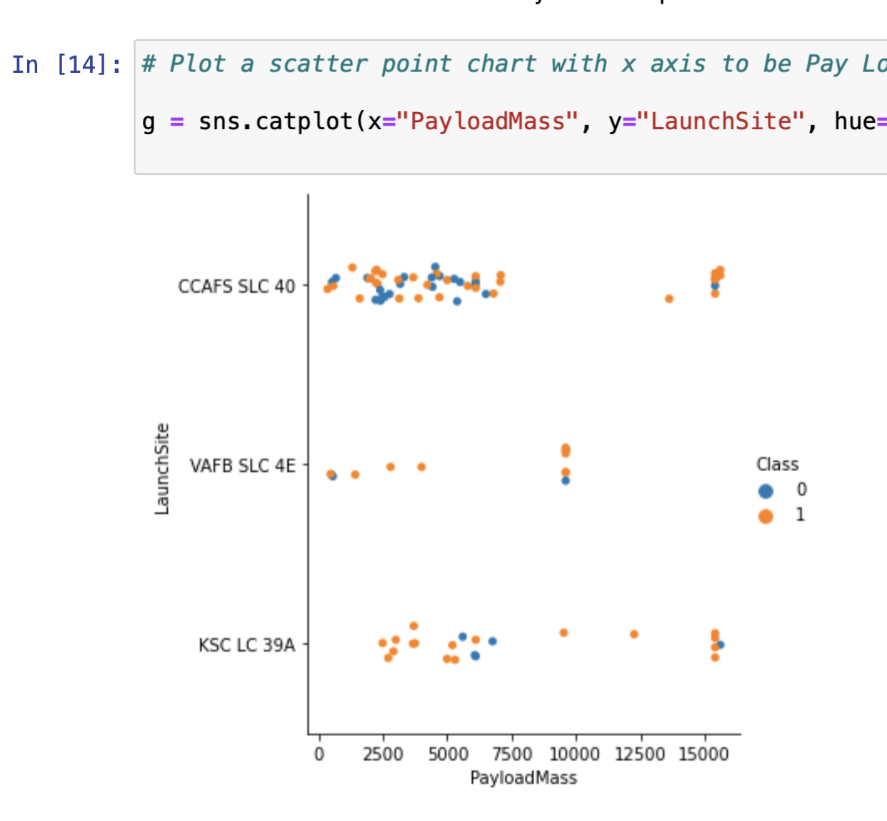
Payload vs. Launch Site
The greater the payload mass for all launch sites gives better launch results.
Small mass amount in KSC LC is also provides better launches.
However, a significant pattern cannot be found using this visualization to make a decision if the Launch Site is dependant on Pay Load Mass for a success launch.

Slide 19
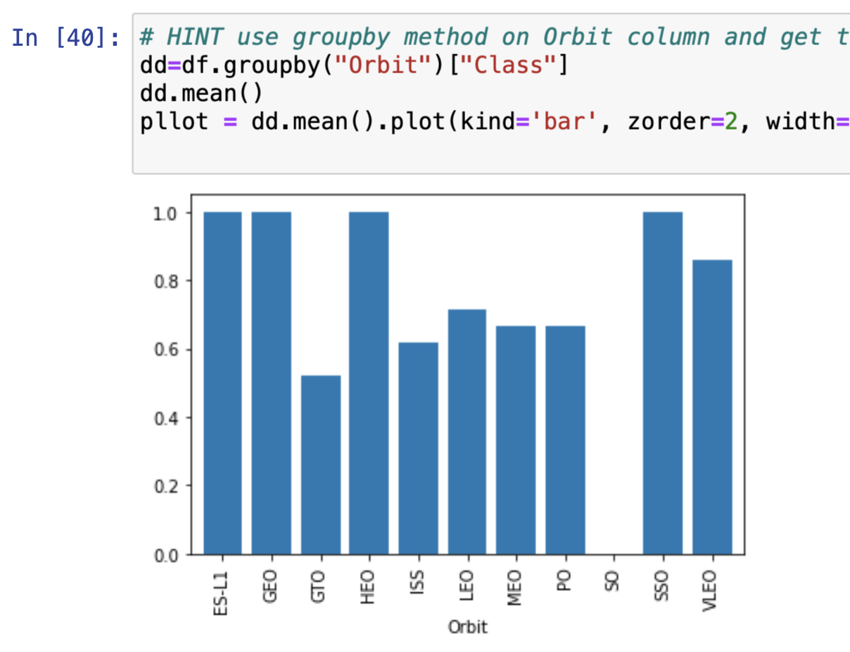
Success Rate vs. Orbit Type
The orbits with the highest success rate
GEO
HEO
SSO
ES-L1
The orbit with the lowest success rate
SO

Slide 20
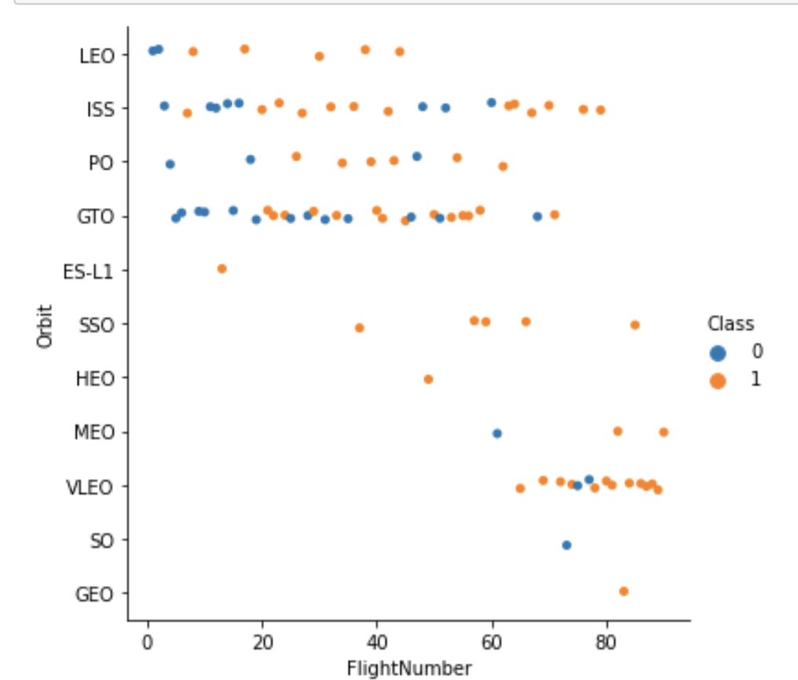
Flight Number vs. Orbit Type
We see that in the LEO orbit the Success appears related to the number of flights; on the other hand, there seems to be no relationship between flight number when in GTO orbit.

Slide 21
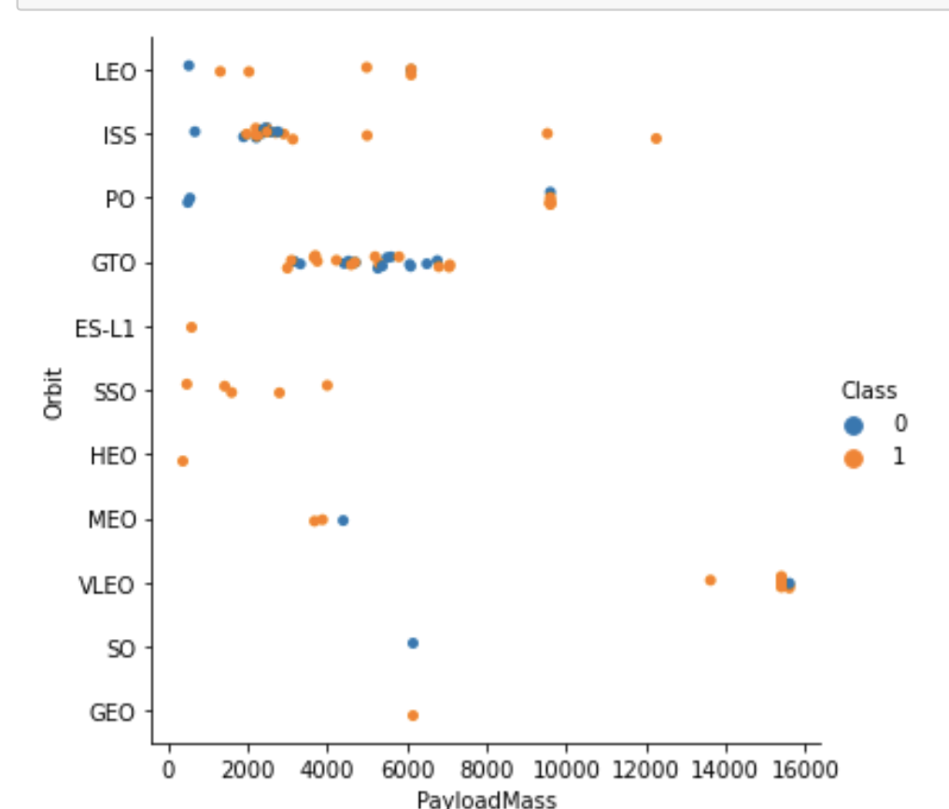
Payload vs. Orbit Type
With heavy payloads the successful landing or positive landing rate are more for Polar,LEO and ISS.
However for GTO we cannot distinguish this well as both positive landing rate and negative landing(unsuccessful mission) are both there here.

Slide 22
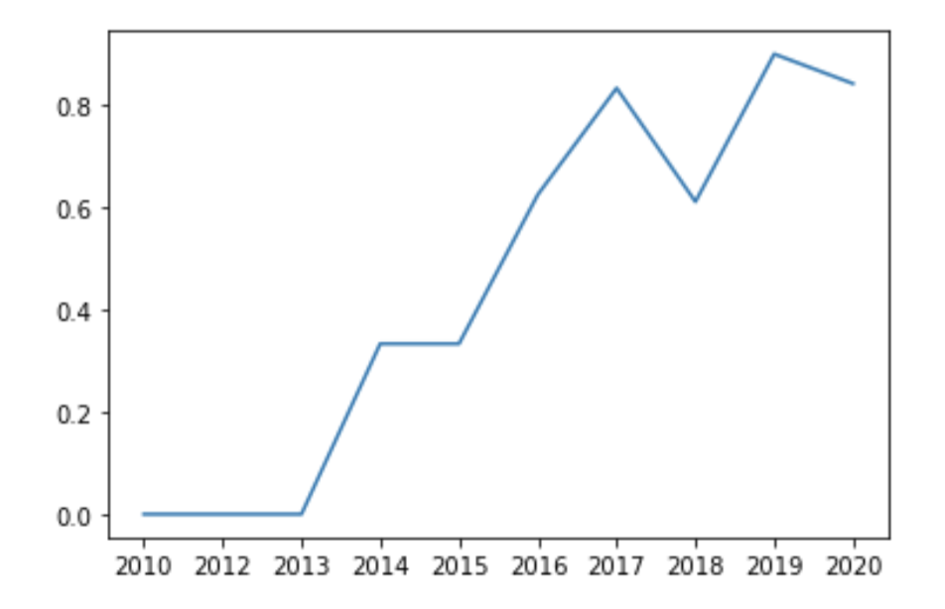
Launch Success Yearly Trend
We can observe that the success rate since 2013 kept increasing till 2020.
There is no launch data for the year 2011

Slide 23
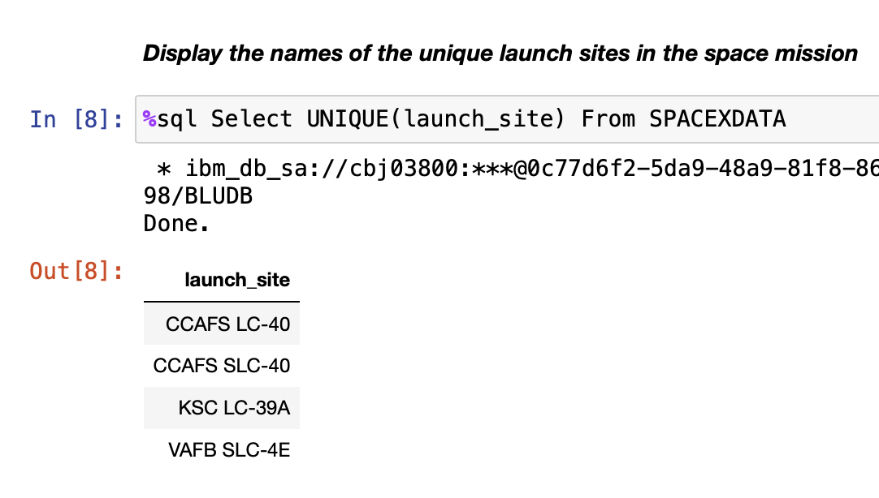
All Launch Site Names
UNIQUE
in the query means that it will only show Unique values in a column

Slide 24
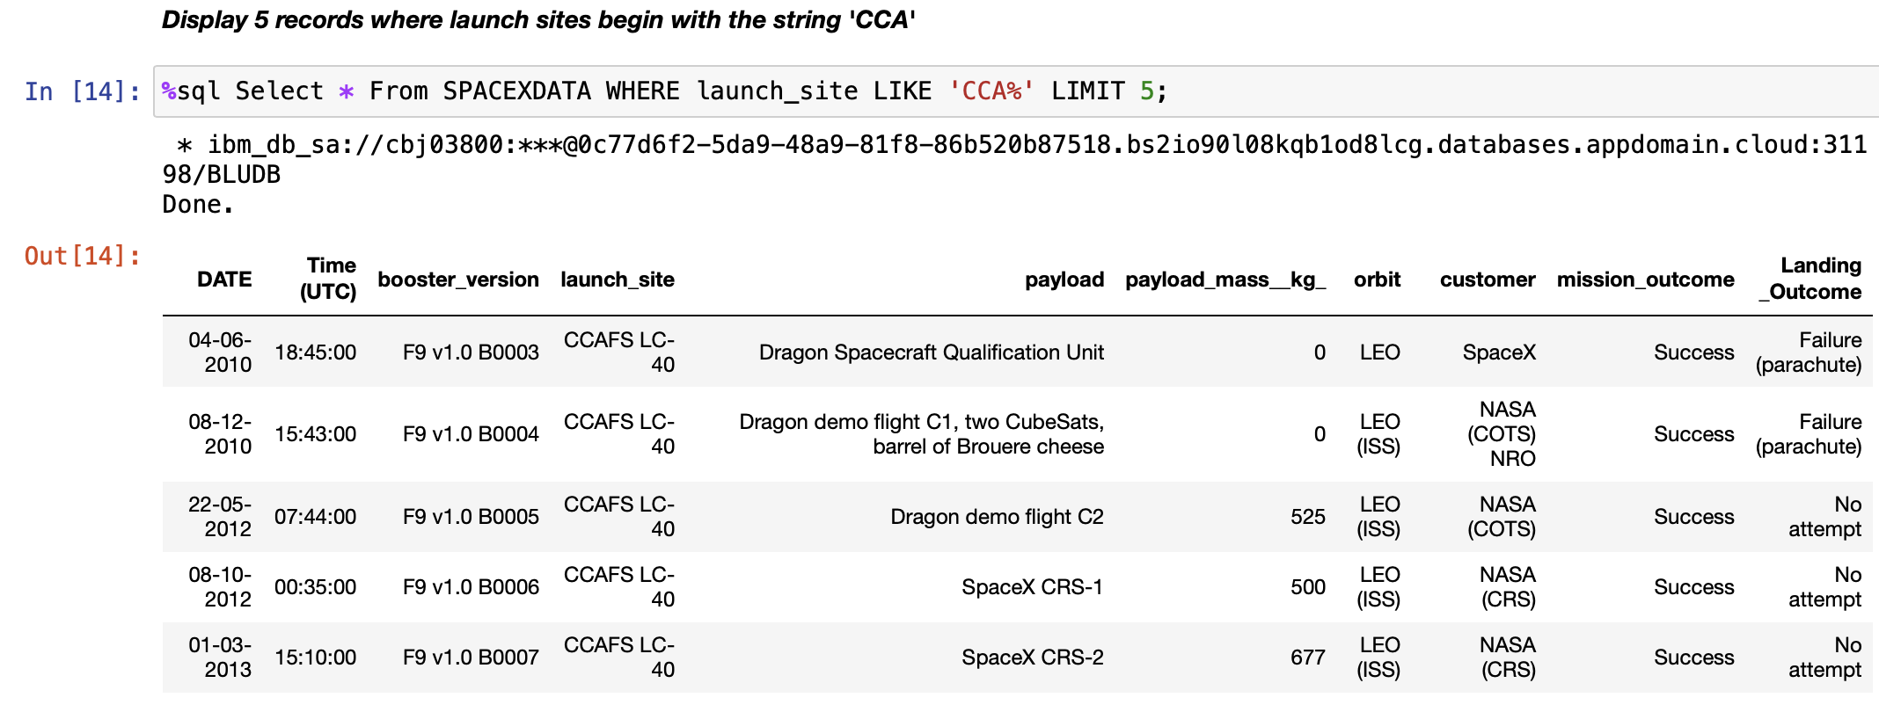
Launch Site Names Begin with 'CCA'
LIMIT
in the query means that it will only show selected amount of rows in order
%
in a string is utilized to search a certain part of a string

Slide 25
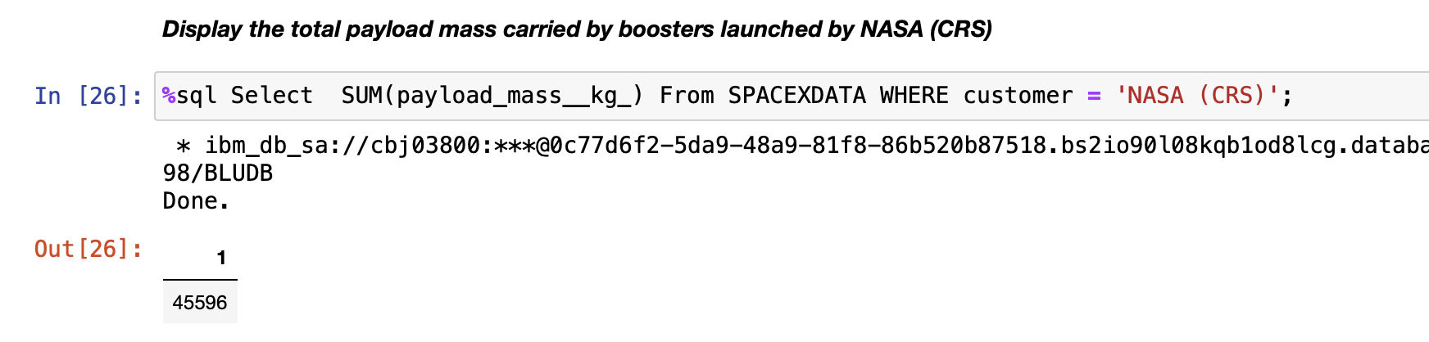
Total Payload Mass
SUM
in the query means that it will summates the total in the column.
WHERE
clause filters the dataset to only perform calculations on certain rows

Slide 26
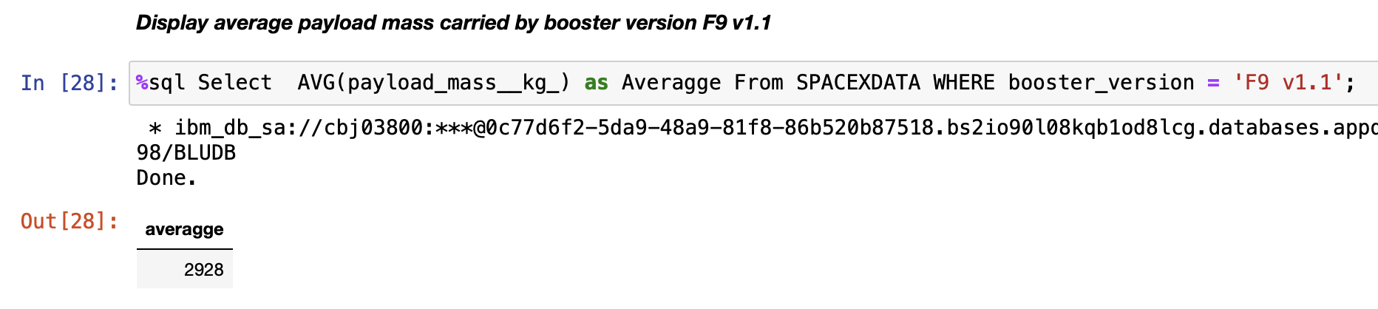
Average Payload Mass by F9 v1.1
AVG
in the query means that it will averages the values in a column.
WHERE
clause filters the dataset to only perform calculations on certain rows

Slide 27
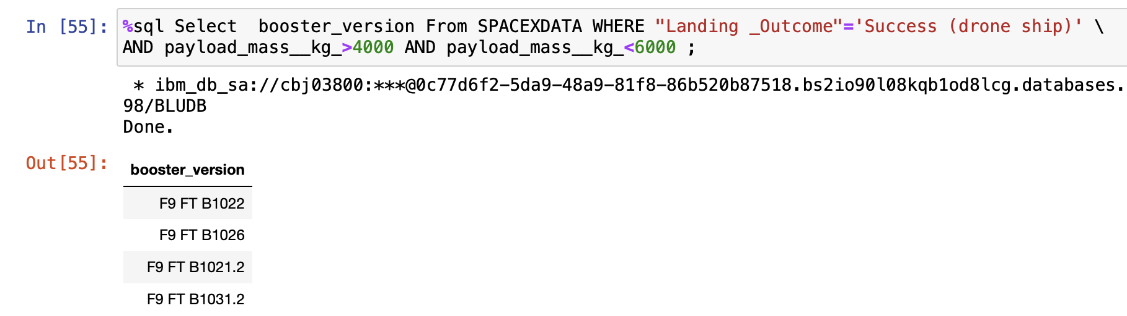
Successful Drone Ship Landing with Payload between 4000 and 6000
AND
clause specifies additional filter conditions
“<“ “>”
we can do logical operations in numbered columns

Slide 28
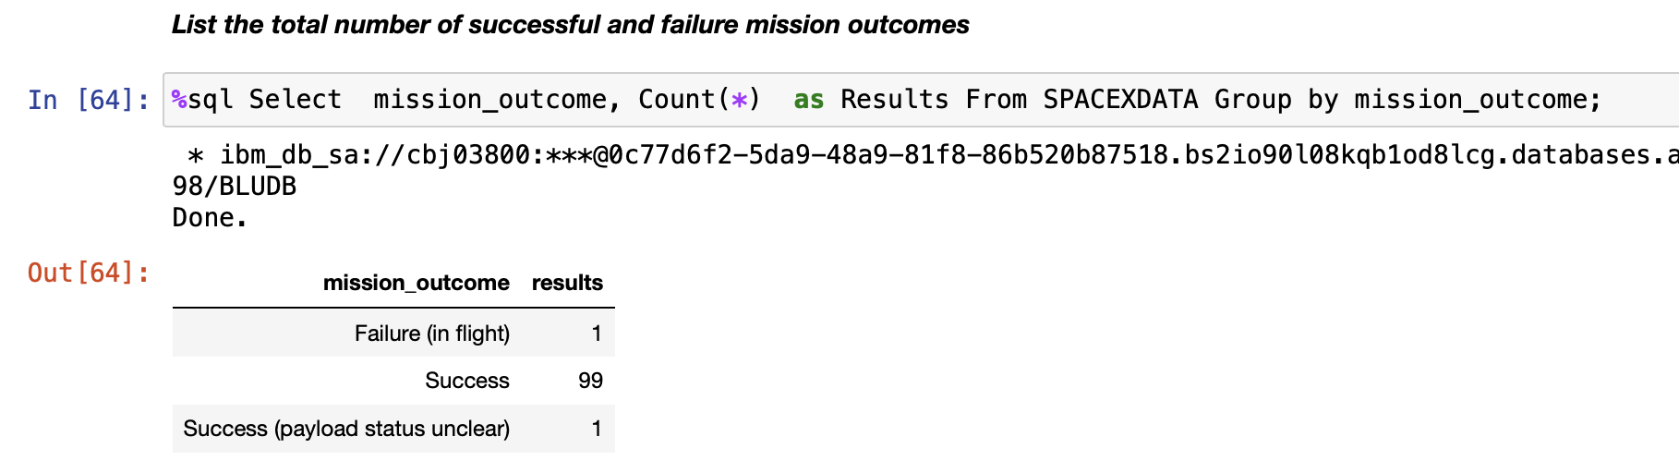
Total Number of Successful and Failure Mission Outcomes
GROUP BY
clause groups the same values in a certain columns
COUNT
Calculates the total amount of instances in a column

Slide 29
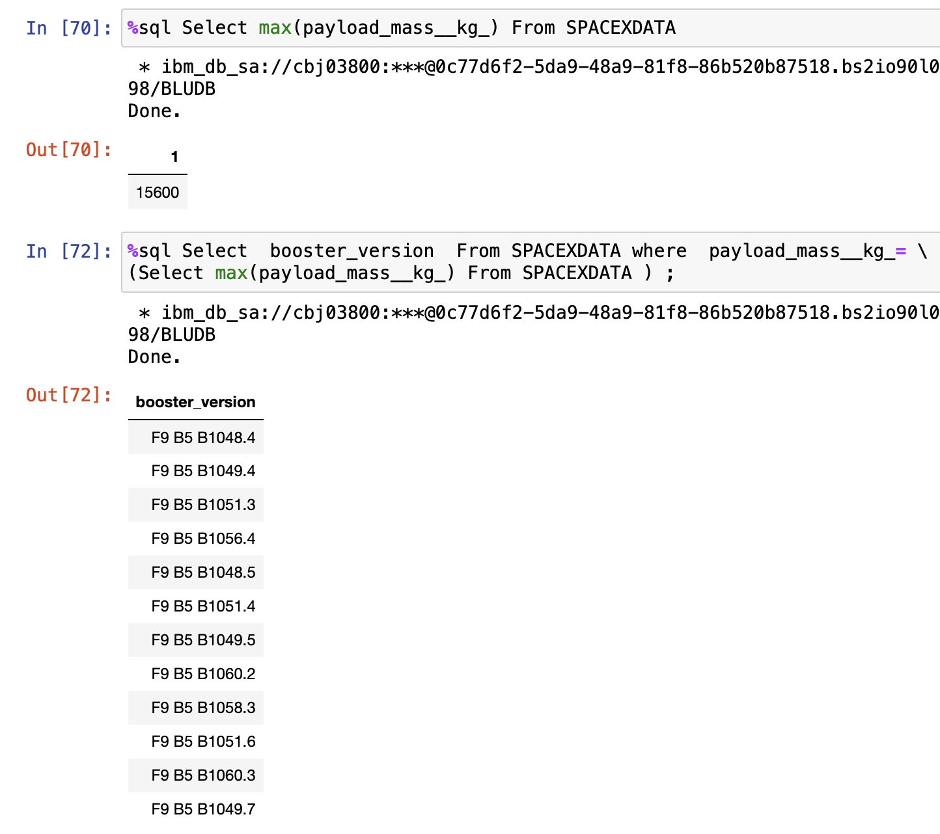
Boosters Carried Maximum Payload
Sub-Query
In SQL we can use subqueries to get the wanted results
MAX
Gives the maximum value in a column

Slide 30
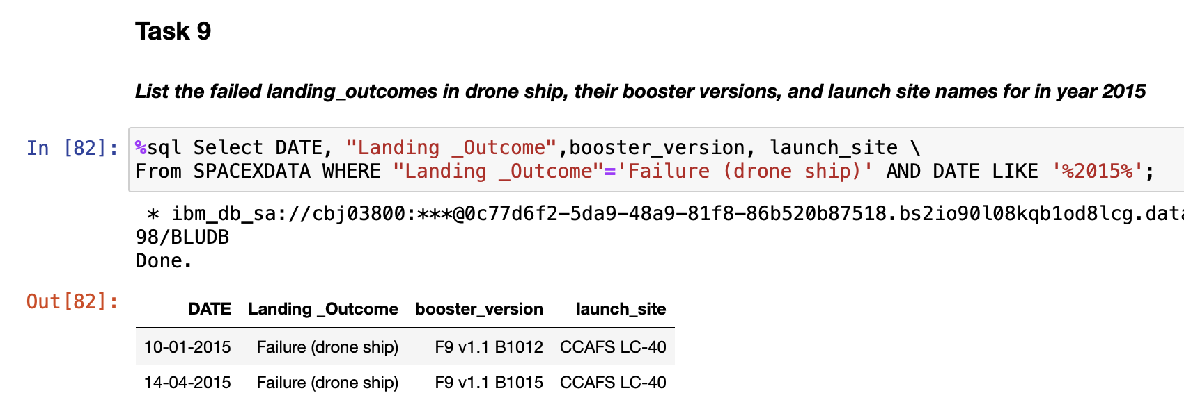
2015 Launch Records
ORDER BY
Sorts the values for a certain column
WHERE
clause filters the dataset to only perform calculations on certain rows

Slide 31
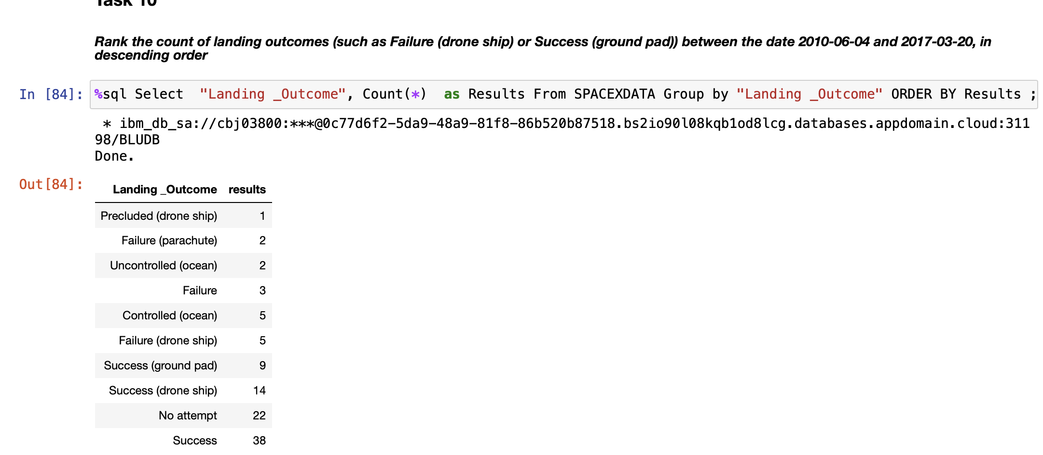
Rank Landing Outcomes Between 2010-06-04 and 2017-03-20
ORDER BY
Sorts the values for a certain column

Slide 32


Slide 33
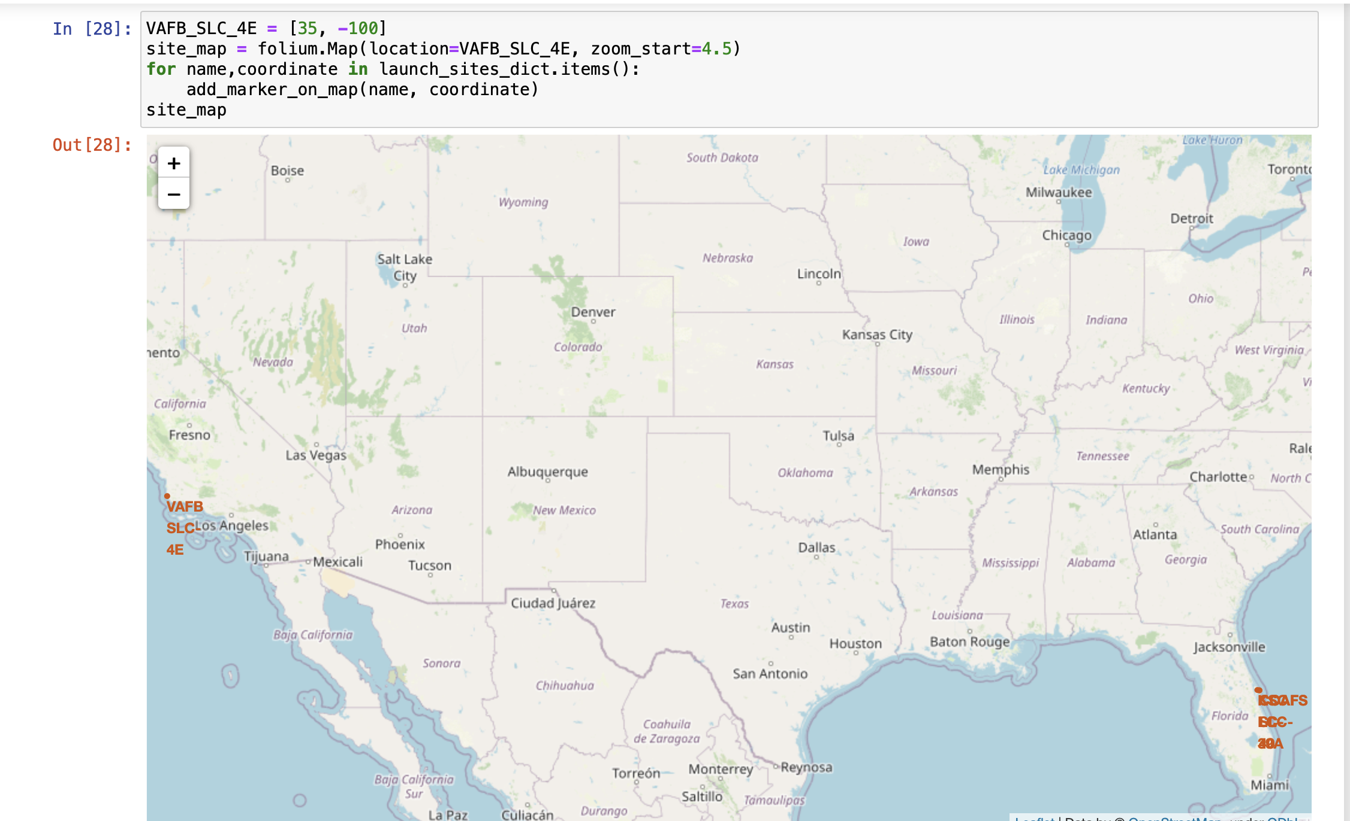
Folium Map Screenshot 1
SpaceX launch sites are located in the western and eastern United States of America.

Slide 34
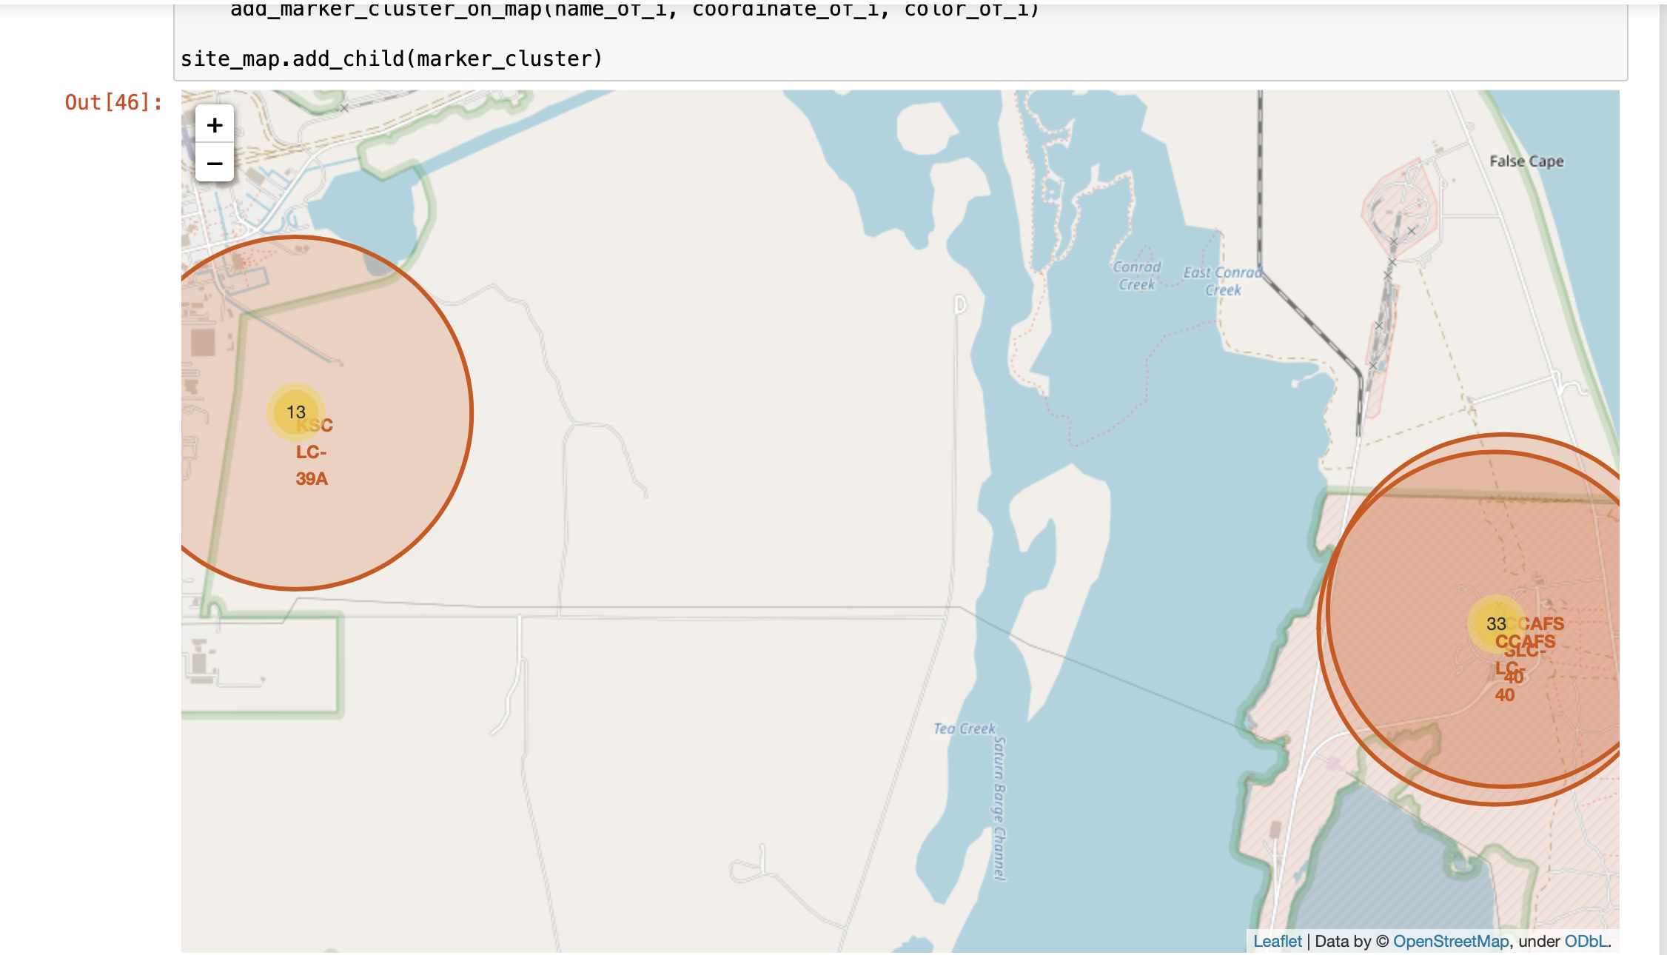
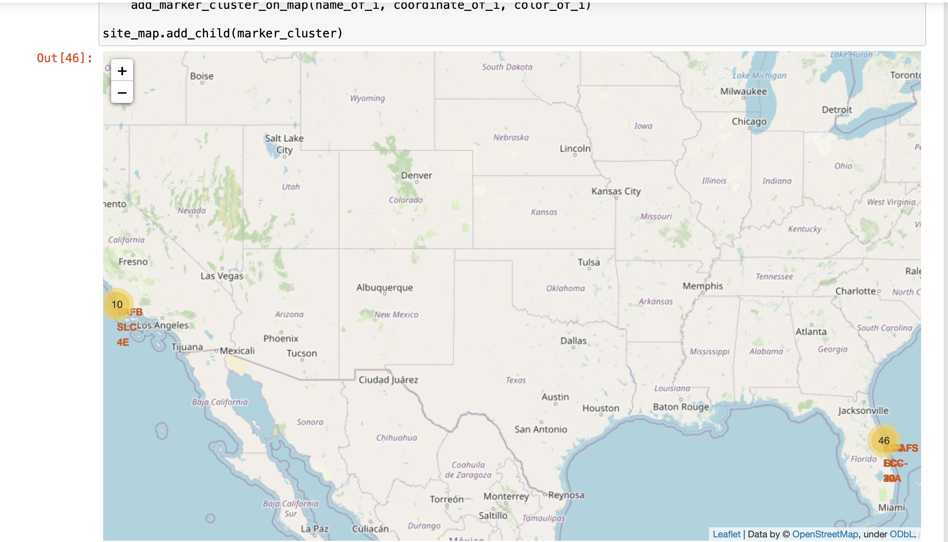
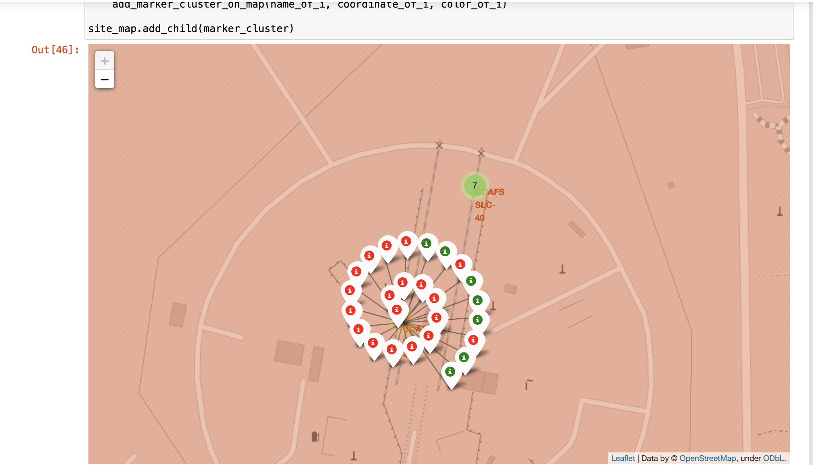
Folium Map Screenshot 2

Slide 35


Slide 36
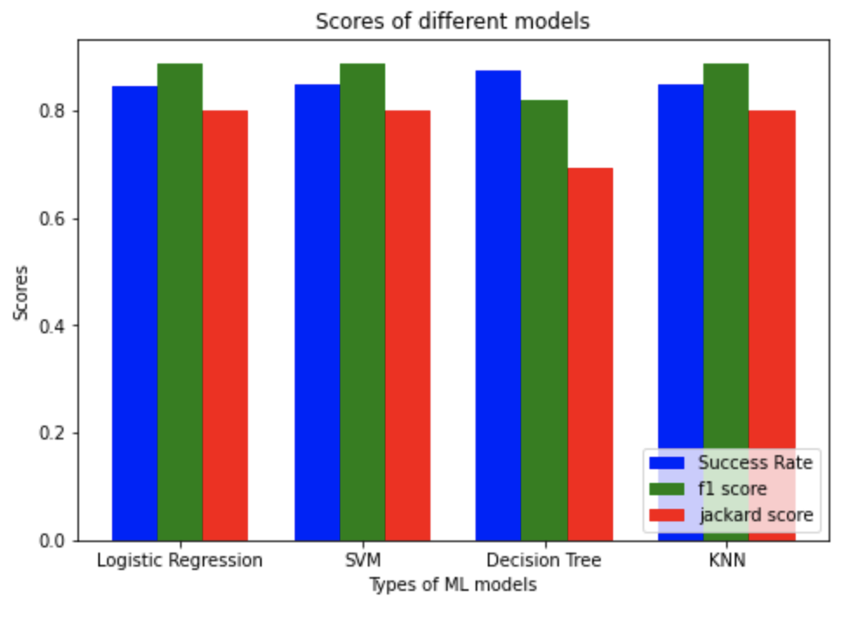
Classification Accuracy
As we look at different tests, each model shows various characteristics on these tests.
Since we are asked to find the best model in terms of accuracy decision tree algorithm is the winner.
In terms of f1_score Logistic regression is the winner.
In terms of jaccard score SVM is the winner

Slide 37
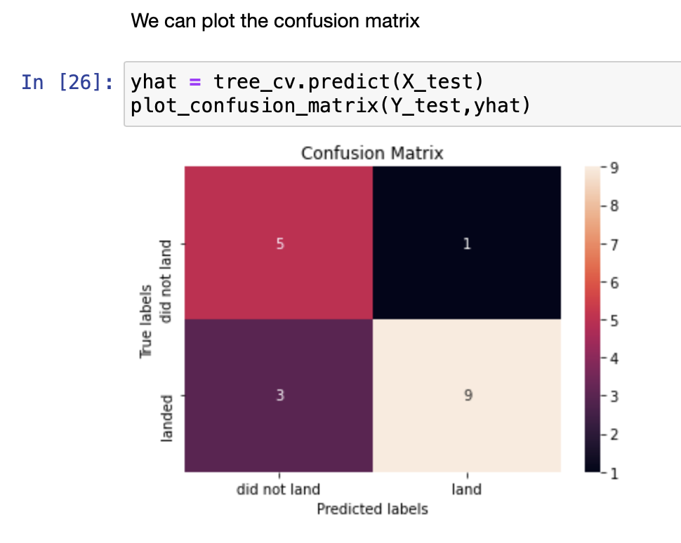
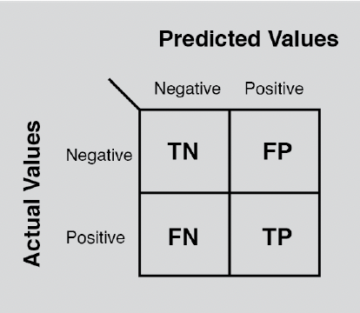
Confusion Matrix
Confusion matrix results of the models are pretty same.
Here, we show the confusion matrix of decision tree algorithm since it has the highest success ratio.
Note that, accuracy = (TP+TN)/Total

Slide 38
Conclusions
The Decision Tree Algorithm is the best for Machine Learning for this dataset in terms of accuracy.
In terms of f1_score and jaccard score; logistic regression and SVM are the winners, respectively.
•The success rates for SpaceX launches is directly proportional time in years and it is increased to the levels of 100% in the recent years.
Orbits named GEO,HEO,SSO,ES-L1 has the best success rates and SO has the lowest success rate.
We can see that KSC LC-39A had the most successful launches among all the sites.

Slide 39


